Slide 1
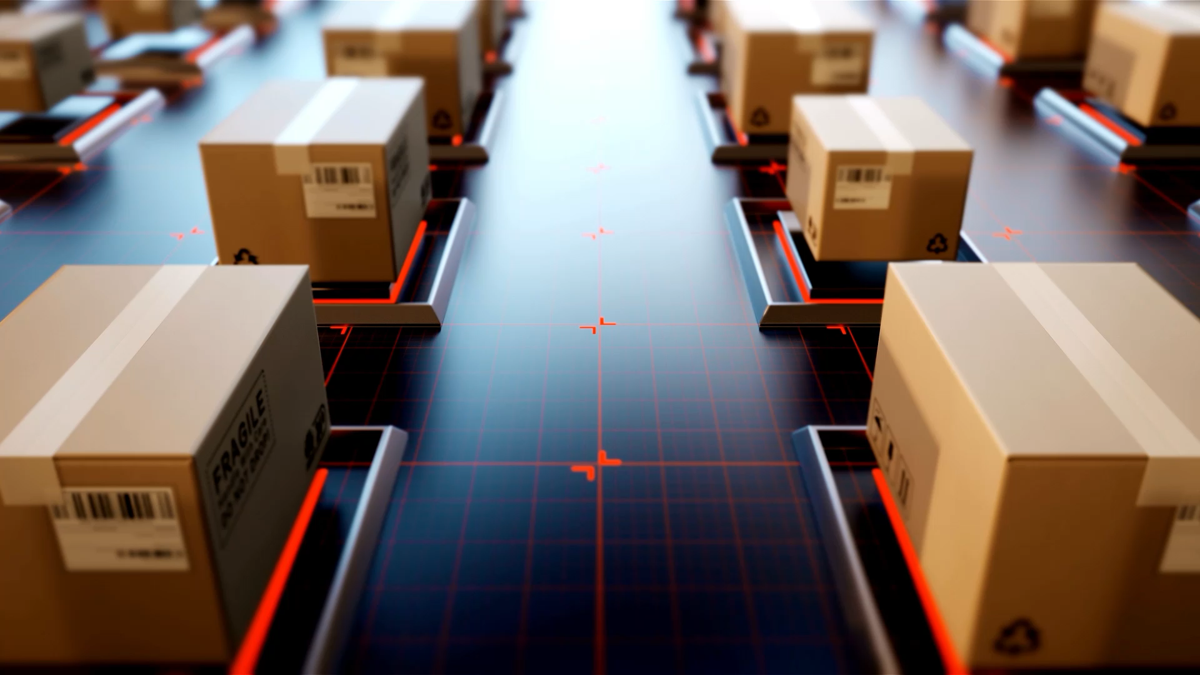
3D Reconstruction SOTA methods

Slide 2
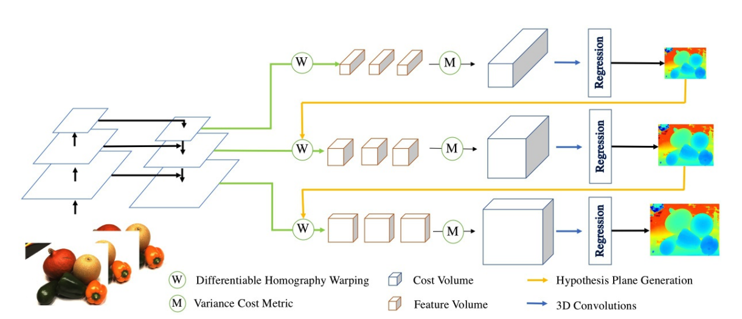
CascadeMVSNet - 2019

Slide 3
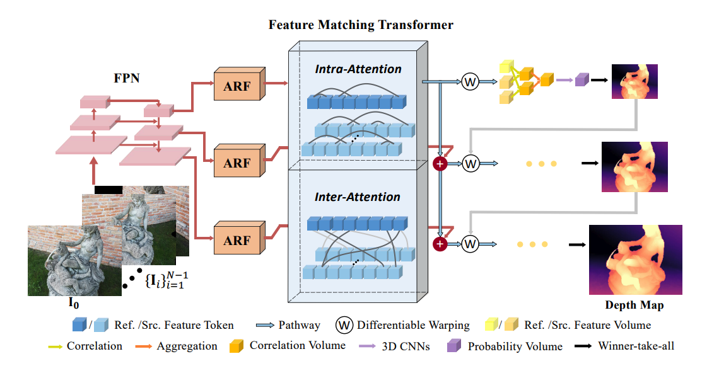
TransMVSNet - 2021

Slide 4
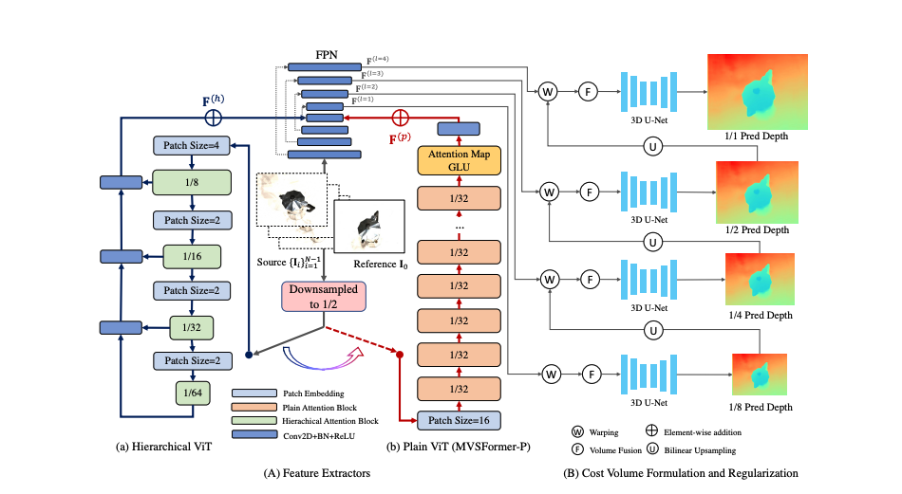
MVSFormer - 2022

Slide 5
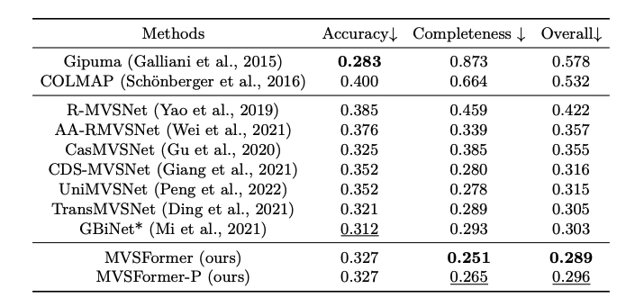
Metrics

